Slide 1

Logistics Operations Analysis
Aerolink Fleet Performance & Operational Study
Date: May 29, 2026
Analyst: Fashina Isaac
Period: 2022 – 2024

Slide 2



Agenda
01. Overview
02. Performance
03. Routes
Dataset architecture and primary operational KPIs.
Revenue stability trends and top customer concentration.
Profitability mapping and On-Time Delivery analysis.
04. Costs
05. Risk
06. Recommendations
Fuel efficiency benchmarking and maintenance trends.
Safety incident liability and DOT compliance overview.
Strategic roadmap for operational growth and ROI.

Slide 3


Dataset Architecture & KPIs
$262.5M
85,410
$5.7M
$2.7M
44.61
REVENUE
TOTAL LOADS
MAINT. COST
INCIDENT CLAIMS
OTD. RATE(%)
System Integration
A relational database architecture linking 14 core operational tables. The analysis focuses on a 3-year performance window (Jan 2022 – Dec 2024), capturing the full lifecycle of trip execution, driver metrics, and cost events.

Slide 4

Monthly Revenue Stability
Jan 2022Jan 2023Jan 2024Dec 2024
Insight: Monthly revenue remains stable at ~$7.3M. However, Dec 2024 performance is lower than Jan 2022, indicating commercial stagnation. Growth requires new lanes or higher per-mile pricing strategies.

Slide 5
Top 10 Customer Segmentation
Note: The top 15% of the customer base generates ~60% of total revenue. Strategic account management is vital for maintaining current revenue plateaus.

Slide 6
Route Profitability Comparison
Routes | typical_distance_miles | total_revenue | avg_revenue_per_mile
Charlotte, NC --> Portland, OR | 2627 | $9,979,092 | $2.69
Phoenix, AZ --> Philadelphia, PA | 2389 | $9,757,537 | $2.71
Columbus, OH --> Portland, OR | 2332 | $9,586,537 | $2.70
Columbus, OH --> Los Angeles, CA | 2269 | $9,501,202 | $2.73
Las Vegas, NV --> Kansas City, MO | 1311 | $5,053,015 | $2.70
Minneapolis, MN --> Houston, TX | 1216 | $4,784,672 | $2.75
Dallas, TX --> Denver, CO | 762 | $2,915,300 | $2.62
Columbus, OH --> Minneapolis, MN | 720 | $2,752,205 | $2.62
Las Vegas, NV --> Los Angeles, CA | 262 | $1,047,474 | $2.63
Philadelphia, PA --> New York, NY | 92 | $393,429 | $2.78
Analysis: Long-haul routes generate high absolute revenue, but shorter regional lanes (e.g., Philadelphia – New York) exhibit significantly higher revenue efficiency at $2.78 per mile.

Slide 7

Service Quality: On-Time Delivery (OTD)
Top 10 Routes | otd_rate(%)
Houston-->Portland | 48
Kansas City-->Miami | 47.3
Las Vegas-->Los Angeles | 47.1
Dallas-->Denver | 46.9
Miami-->Philadelphia | 46.6
New York-->Columbus | 46.6
Kansas City-->Los Angeles | 46.5
Philadelphia-->Seattle | 46.4
Detroit-->Houston | 46.4
Kansas City-->Indianapolis | 46.2
Critical Issue
Systemic delays at coastal facilities (detention time) are eroding customer trust. Urgent scheduling audits required.

Slide 8

Driver Performance & Efficiency
Efficiency Benchmark
Elite drivers (Top 25%) achieve an average of 7.4 MPG through speed discipline and idle management.
Standard drivers (Bottom 26%) average 5.8 MPG with 16% idle time.
Opportunity: Closing this gap represents a recoverable value of $1.2M/year in fuel savings.

Slide 9




Fuel Spend Volatility
39.2%
34.2%
FUEL AS % REVENUE (2022)
FUEL AS % REVENUE (2024)
Market Dependence
The cost reduction is due to lower market diesel prices, not operational efficiency gains. The fleet remains exposed to price shocks.
Efficiency Risk
A return to 2022 prices would result in a $4.3M annual cost increase. Immediate idle-reduction training is critical.

Slide 10
Fleet Maintenance Breakdown
$5.7M Total Cost
Asset Downtime Impact
Preventive maintenance ($963K) is healthy, but repair categories (Tires/Brakes) are nearly as large, indicating corrective over preventive trends.
Downtime: Avg 25.1 hours per event. Reducing this by 2 hours recovers 5,800 productive truck-hours.

Slide 11

Safety Risk & Liability
170
$2.7M
TOTAL INCIDENTS
CLAIMS (3YR TOTAL)
Compliance Findings
•
DOT Violations represent a $581K financial liability.
•
These violations are 100% preventable via equipment inspection and Hours of Service compliance training.

Slide 12
Recomendations
Action Item | Initiative Description | Expected Impact
Predictive Maintenance | Scheduling high-cost trucks before failure points. | Recover 5,800 truck-hours
Incentive Program | Driver bonuses tied to MPG and reduced idle time. | $1.2M Fuel Savings
Pricing Review | Revise long-haul per-mile rates based on market demand. | 5-10% Revenue Growth
Facility Audit | Operational audit of high-delay coastal hubs. | Contract Retention

Slide 13
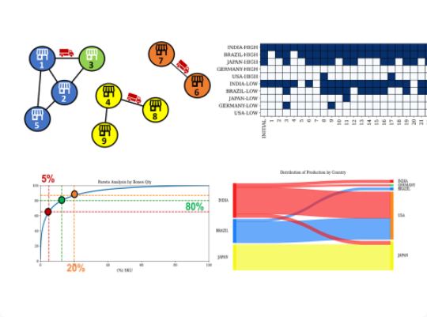
Methodology & Data Integrity
SQL Analytical Framework
Structured cleaning of 85,410 loads using CTEs and window functions for stability analysis.
•
Discovered 1,714 NULL driver_id values via cross-referencing logs.
•
Standardized trip-level timestamps for OTD calculations.

Slide 14
Thank You

